Slide 1

CKAN for Enhanced Public Sector Data Management: A Proof of Concept
Team Name: Accelerating
Notes:
Welcome to our Proof of Concept demonstrating how CKAN can revolutionize data management and decision-making in public sector operations. (10 seconds)

Slide 2


Project Objective
Develop a PoC to showcase CKAN's capabilities in:
Enhancing data management
Improving policy analysis
Streamlining decision-making processes
Image source: ckan.org
Notes:
Our objective was to develop a Proof of Concept demonstrating how CKAN can enhance data management, improve policy analysis, and streamline decision-making in the public sector through improved data workflows. (20 seconds)

Slide 3
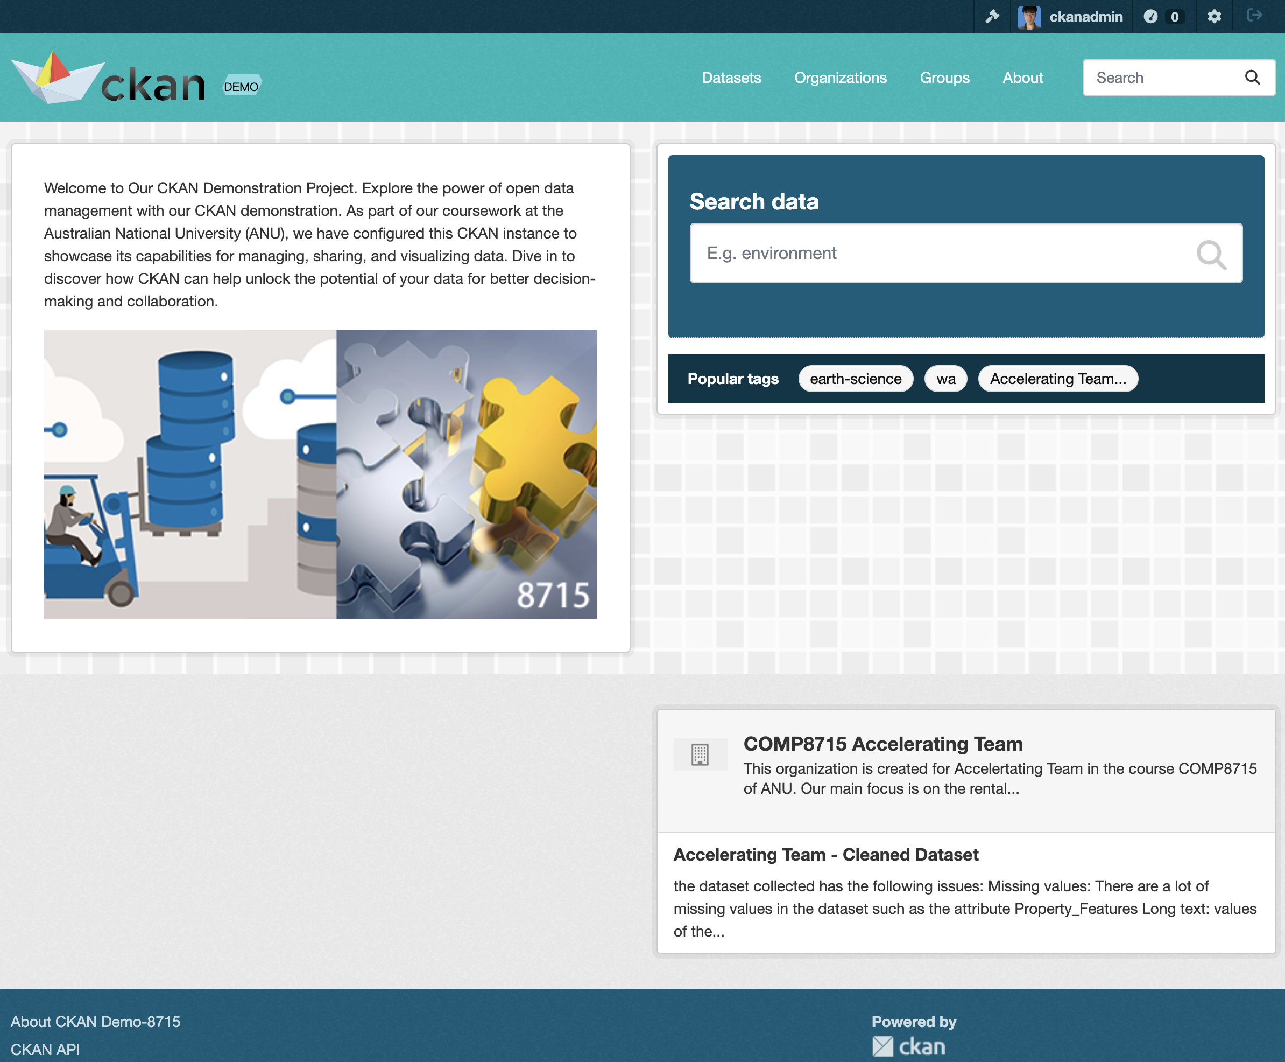
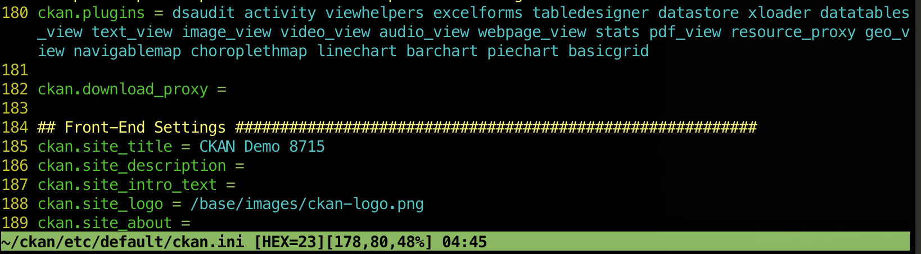
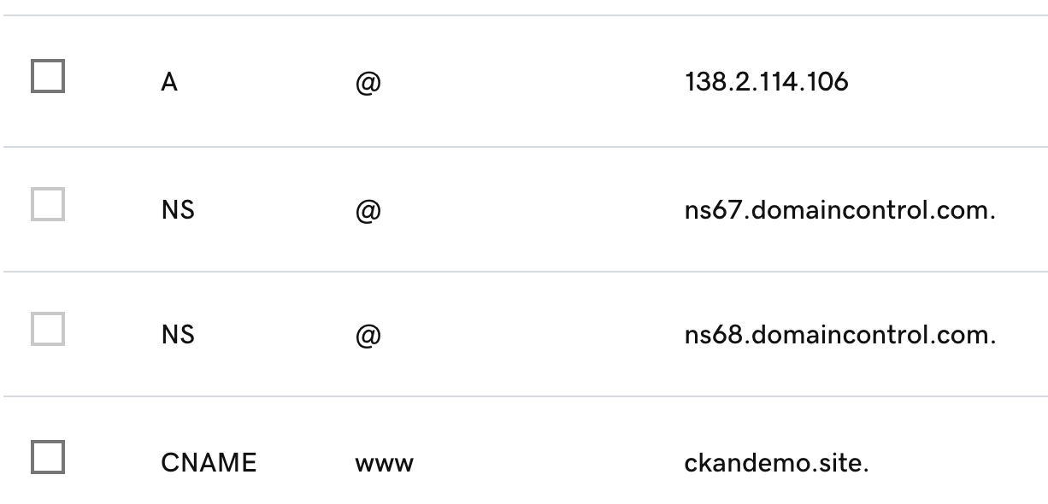

CKAN Implementation
Domain setup and CKAN installation
Configuration for public sector needs
Customization of existing features
Notes:
We implemented CKAN from the ground up, configuring it to meet public sector needs. This involved domain setup, installation, and customization of existing features to create an environment conducive to efficient data management and policy workflows.(30 seconds)

Slide 4
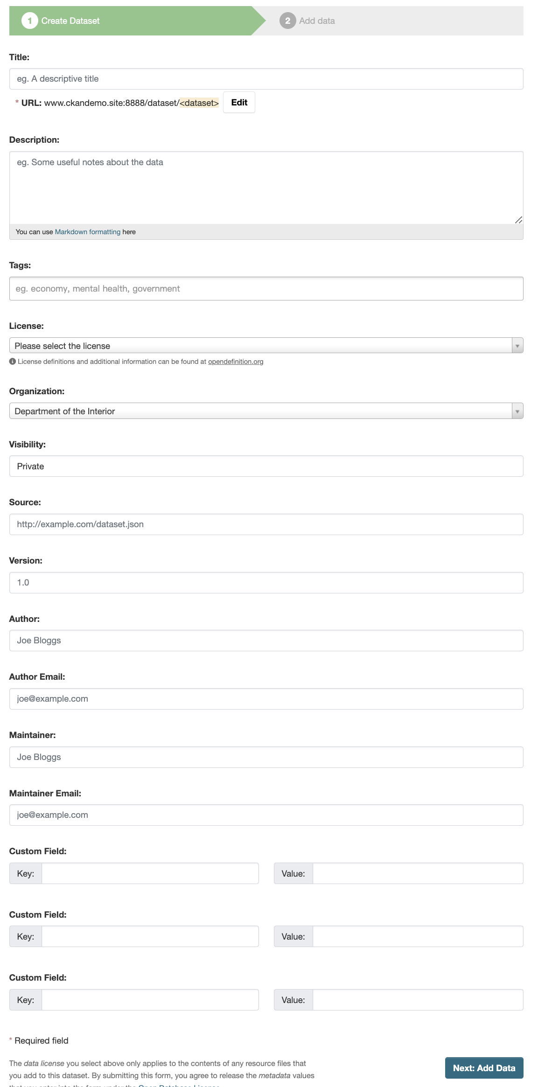
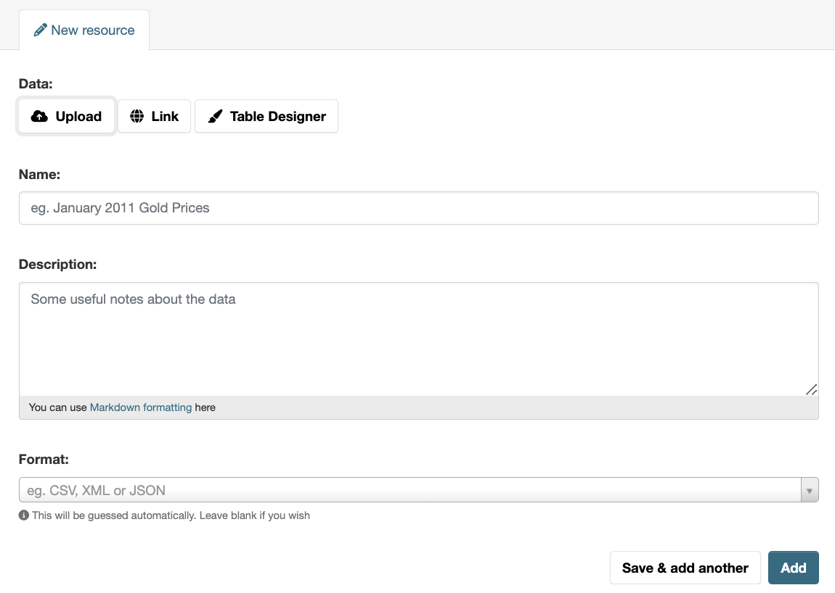
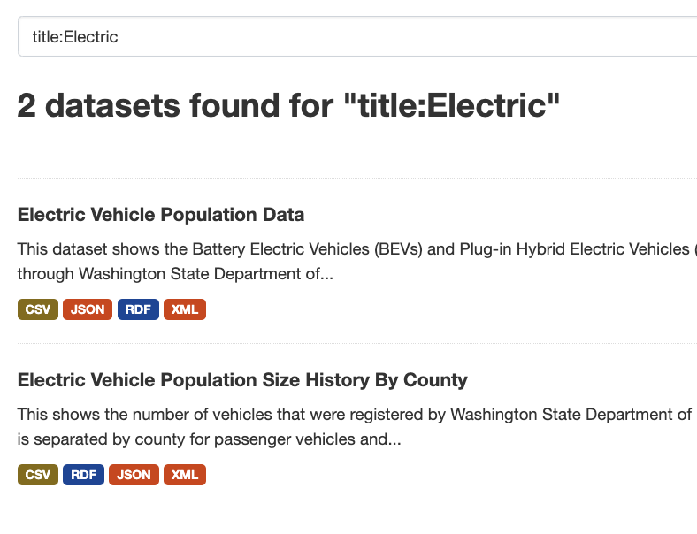
Data Management Enhancements
Centralized data repository
Standardized metadata
Improved data discovery and access
Notes:
Our PoC demonstrates how CKAN enhances data management through a centralized repository, standardized metadata, and improved data discovery. These features significantly streamline the process of storing, finding, and accessing crucial policy-related data.(40 seconds)

Slide 5
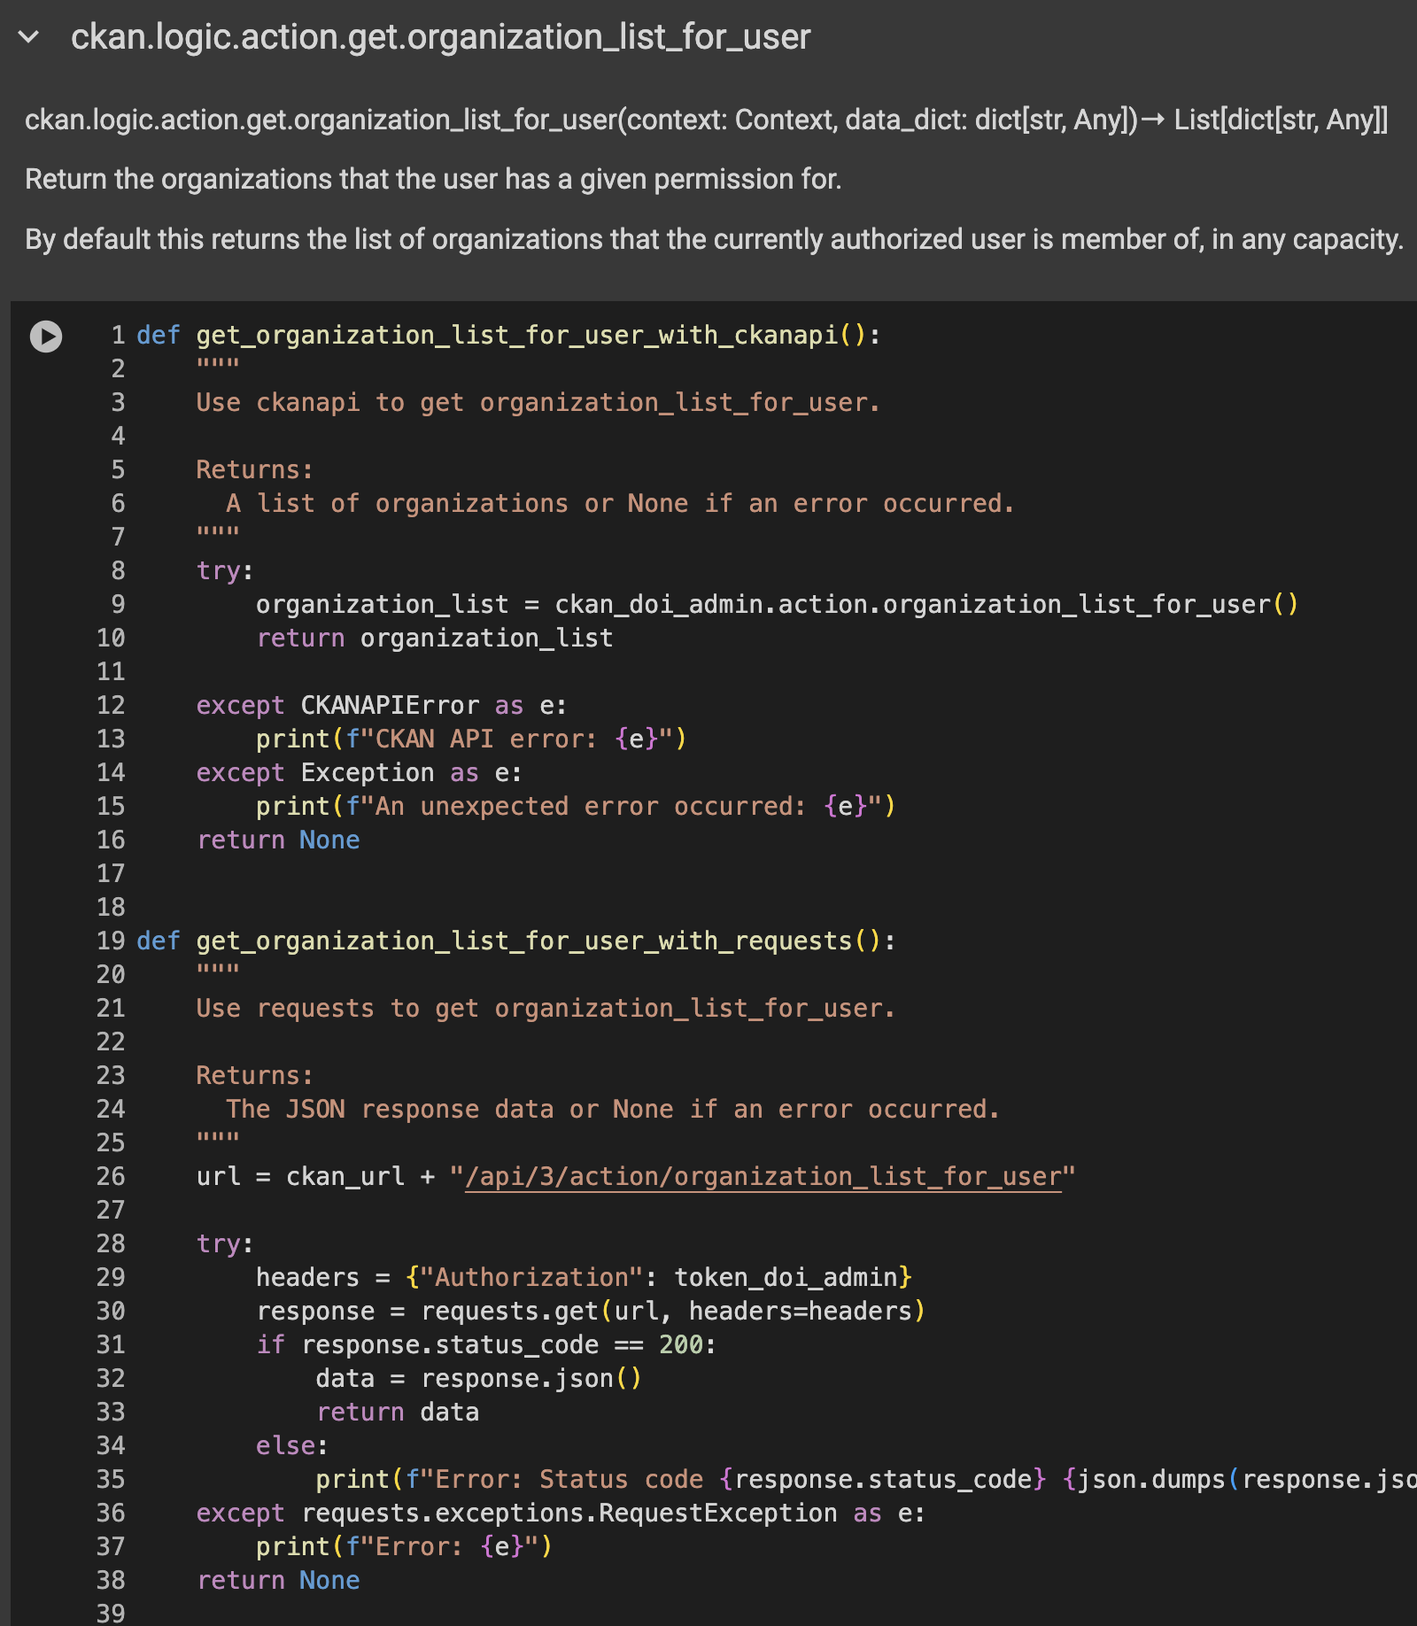
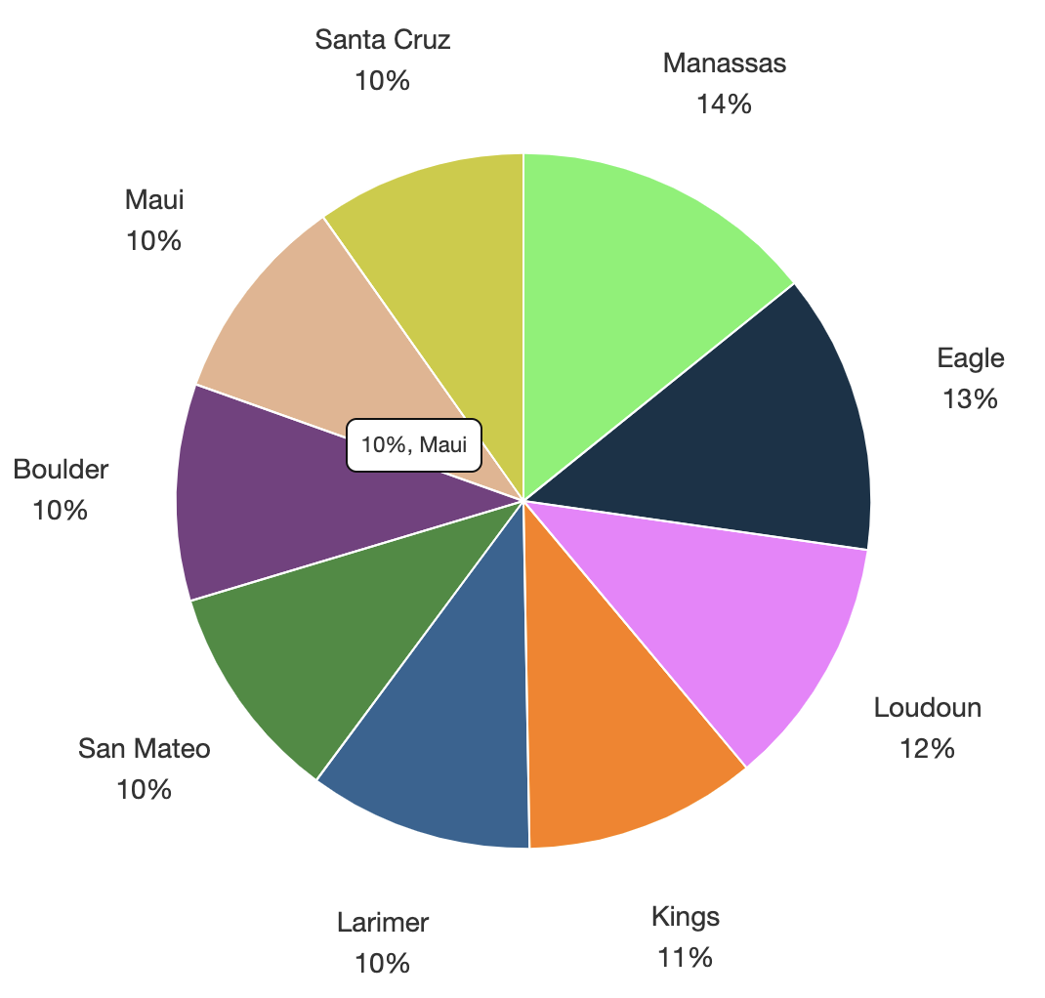
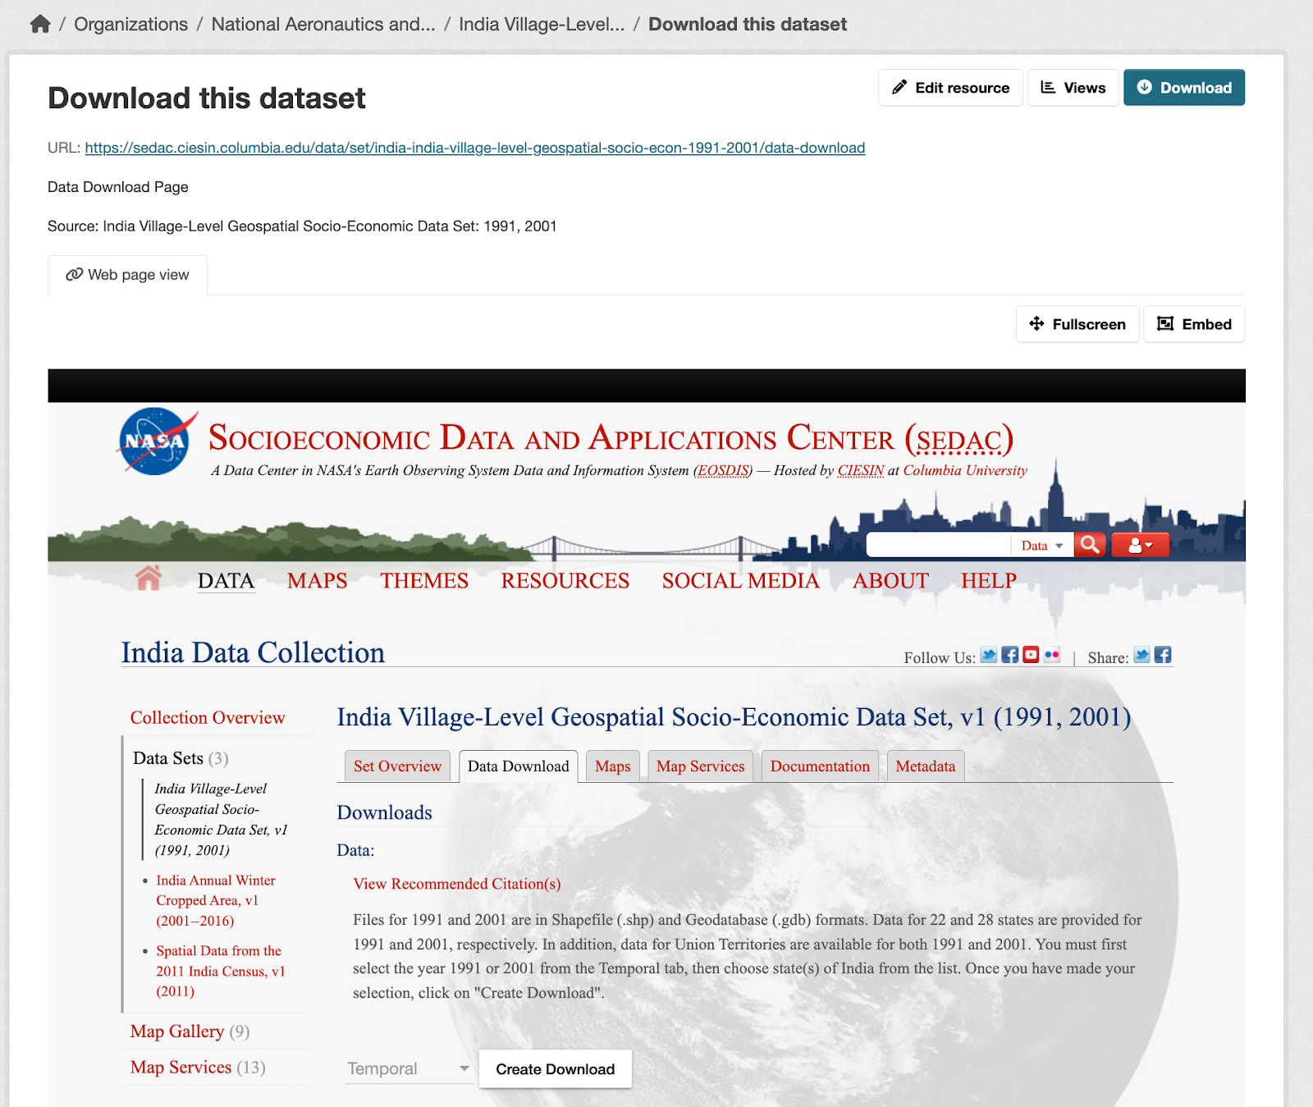
Policy Analysis Improvements
Data visualization tools
Cross-dataset analysis capabilities
API for data access and integration
Notes:
CKAN's built-in tools greatly enhance policy analysis. We've showcased its data visualization capabilities, cross-dataset analysis features, and robust API. These tools enable policymakers to gain deeper insights and make data-driven decisions more efficiently.(40 seconds)

Slide 6
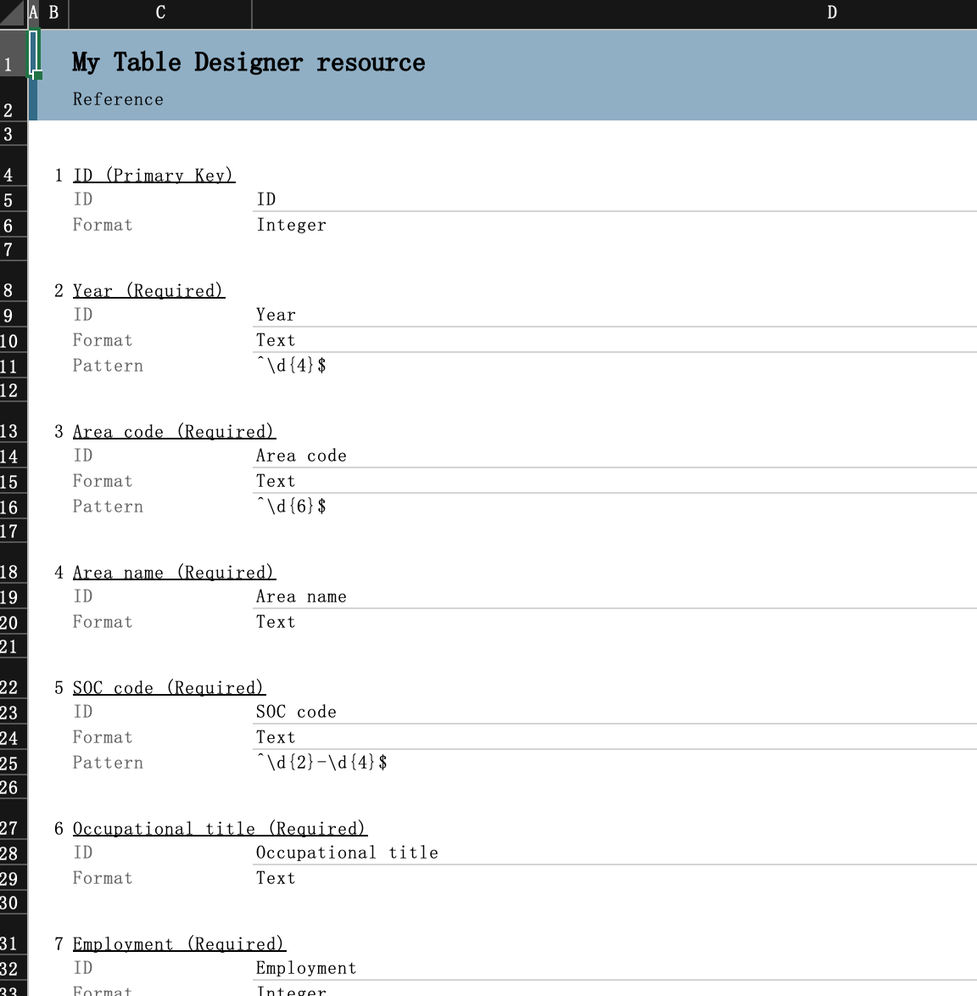
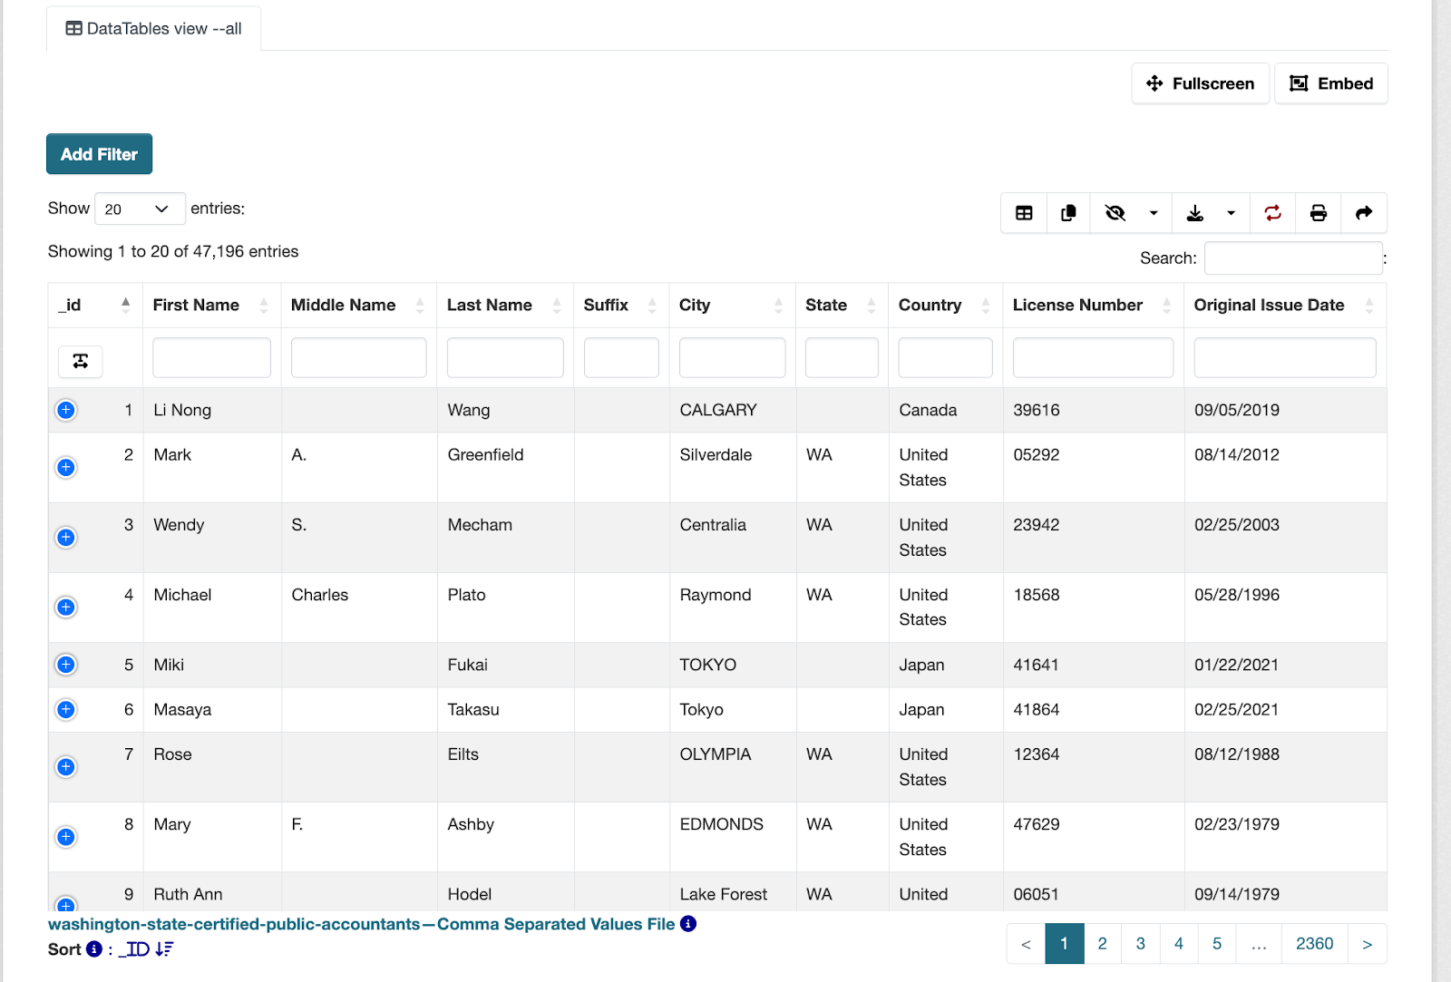
Decision-Making Process Optimization
Real-time data access
Collaborative features
Data-driven insights
Notes:
Our PoC illustrates how CKAN optimizes decision-making processes. Real-time data access, collaborative features, and data-driven insights empower policymakers to make informed decisions quickly and effectively.

Slide 7
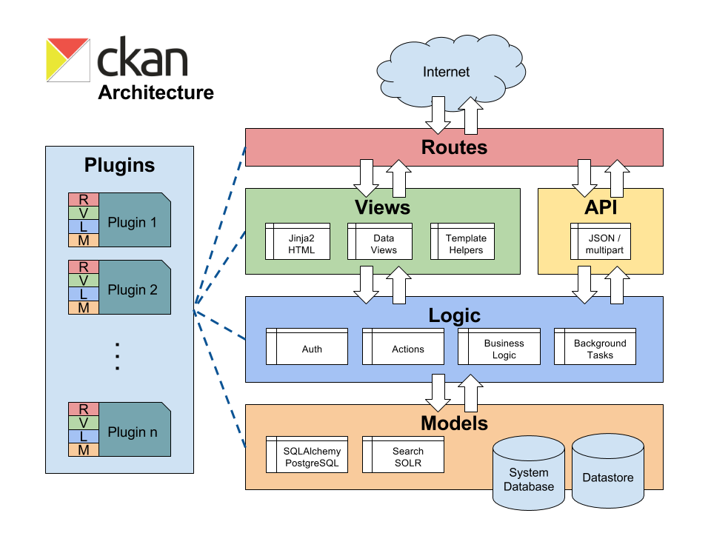


Impact and Future Potential
Improved data accessibility and transparency
Enhanced policy formulation efficiency
Potential for cross-department collaboration
Images source: ckan.org
Notes:
This Proof of Concept demonstrates CKAN's potential to significantly improve data accessibility, enhance policy formulation efficiency, and foster cross-department collaboration in the public sector.

Slide 8
Conclusion
Thank you
Notes:
Thank you for your attention. We believe this PoC clearly showcases CKAN's potential to transform public sector data management and decision-making processes.(10 seconds)

